Slide 1
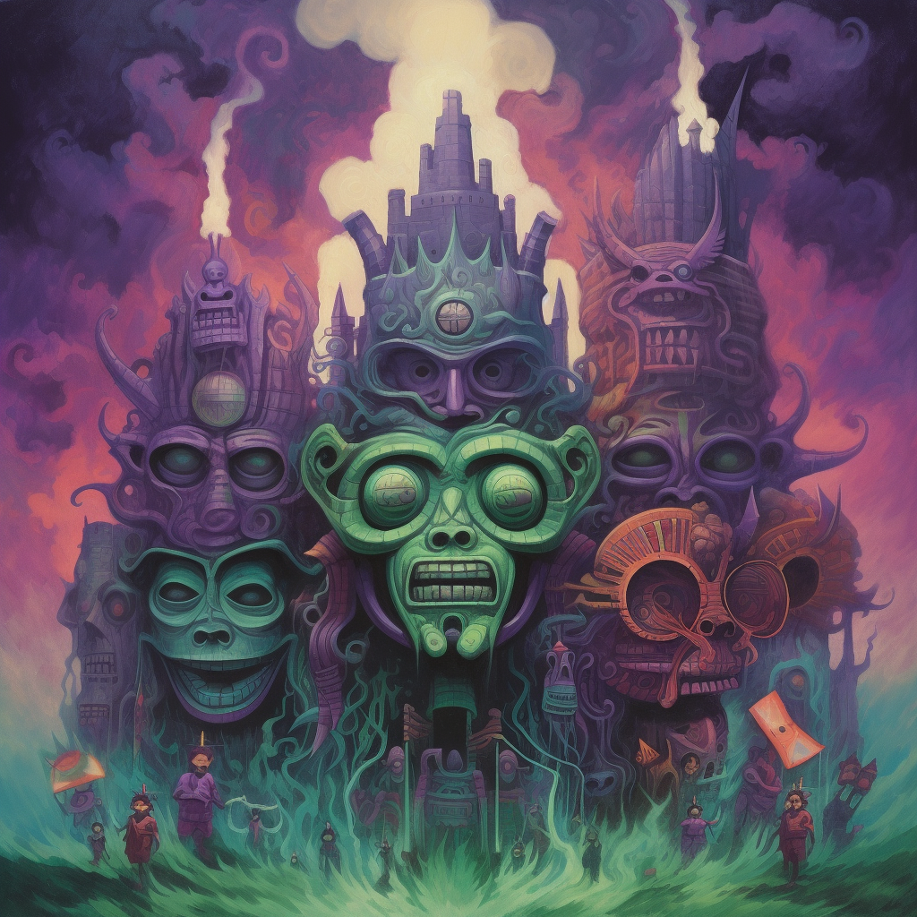
INCURSION
Level Design brief

Slide 2
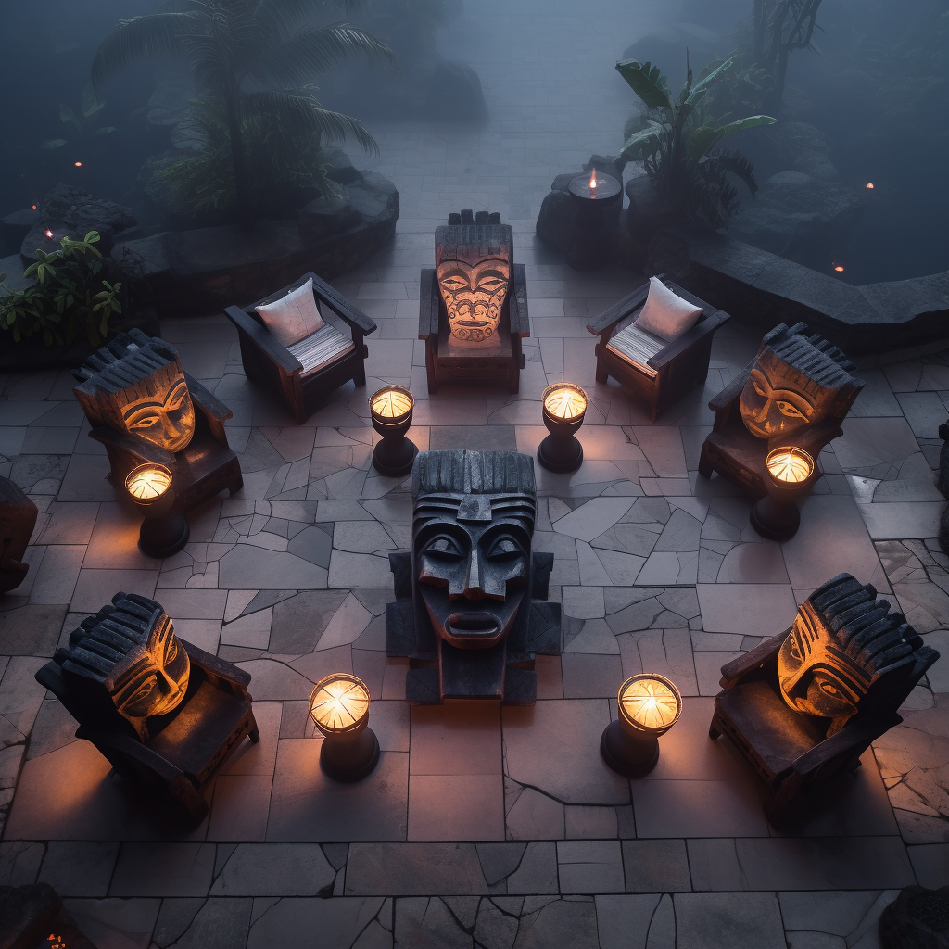
LOOK AND FEEL
Midjourney thought the masks were chairs . . Smh
The central mask is more in theme
This is to kinda show the lighting feel.

Slide 3
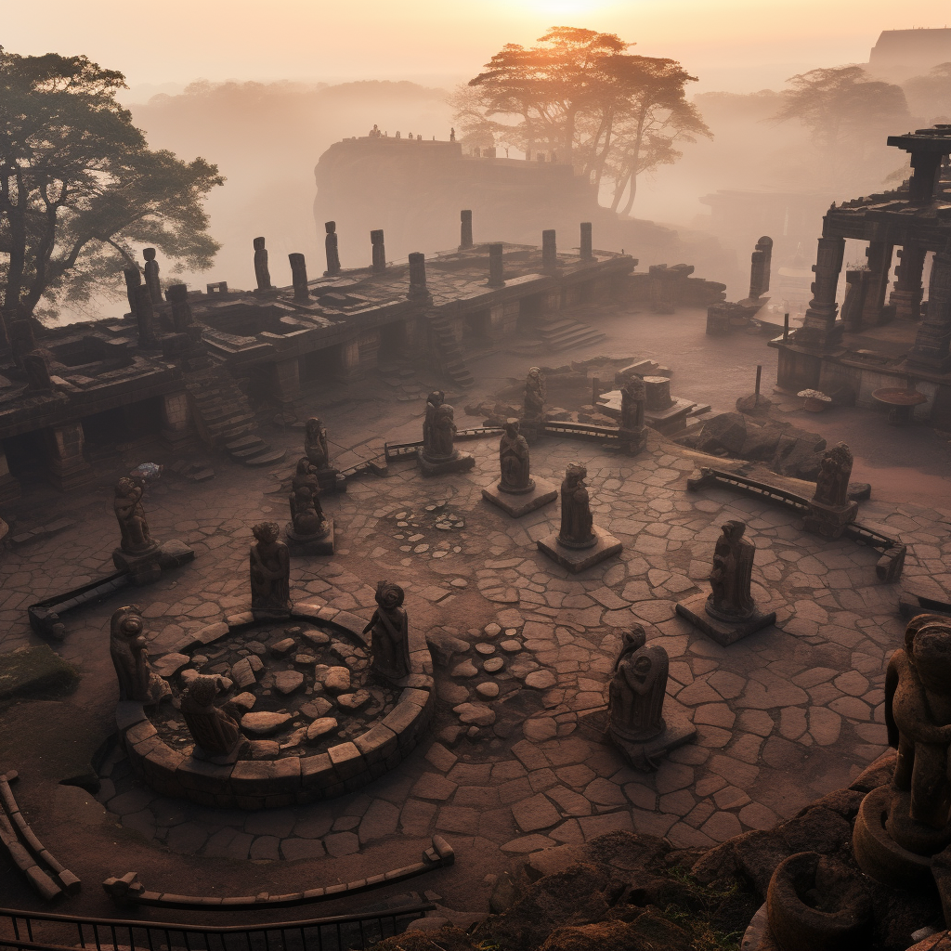
LOOK AND FEEL
Stone ground and bit of atmospheric fog.
Stone masks of various sizes dotted around the area
The background is irrelevant.
Not expecting this amount of realism

Slide 4
Top Down Map
Giant Mask Statue
Wall
5000
5000

